Slide 1
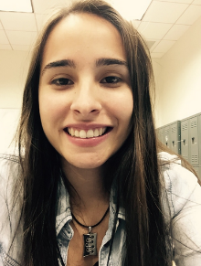
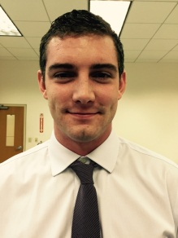
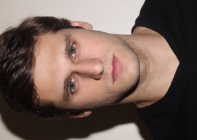
Light Flexible Bulletproof Vest
Faculty Advisor: Dr. Shirazi & Dr. Haider
Course Advisor: Dr. Sarkar
Paola Briceno Aurelio Matthew Leal Teodor Nonov

Slide 2
OUTLINE
Overview
Elevator Speech
Background Research
Competitive Products
Needs and Wants
Problem Definition
Objective
QDF
Final Design
Functional Decomposition
Abaqus Model
Design Model
Manufacturing
Bill of Materials
Manufacturing Process
Retail Price
Test Details
Testing Goals
Testing Procedures
Test Results
Tests 1-4
Results and Discussion
Top Design
Best Practices
Lessons Learned
Timeline
Summary
Future Recommendations
References

Slide 3
OVERVIEW

Slide 4
BODY ARMOR BACKGROUND INFO
Total Industry : $734 Million
79 Businesses
4 Companies Own 52%
Body Armor Customer Basis

Slide 5
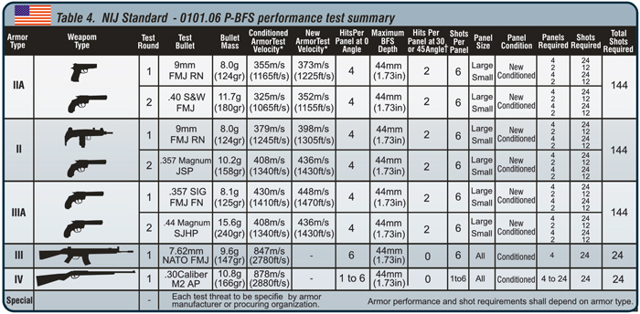
BODY ARMOR CLASSIFICATIONS
Main Focus For Senior Design Project

Slide 6
COMPETITIVE PRODUCTS
Company | Type | Weight | Cost | Materials Use | Contact Information
safeguard clothing | NIJ Level IIIA Ballistic Protection, NIJ Level II edged blade protection NIJ Level II Spike Protection | 5.5lbs | $800 | CoolIMAX lining, poly-cotton, DuPont Kevlar. | Safeguard Clothing Phone# :888 958 0168
GH Armor Systems GH PRO | NIJ LEVEL IIIA Ballistic Protection | _ | $435 | Polycotton carrier lines with akwadyne coolmesh material for comfort, water resistant ballistic panel cover. | 1479 Gillespie Street, Suite 303.Rock Island, Illinois 61201 Phone: 563.823.6652
 | NIJ LEVEL IIIA Ballistic Protection | _ | $705 | designed with 100% Aramid(Kevlar), Polycotton carrier lined with Aquadyne Coolmesh material
Diamondback Tactial | NIJ Level IIIa Ballistic Protection | - | - | Hybrid construction of core felt and UD laminates (Honeywell Spectra shield and gold shield materials) | Diamondback Tactical,LLLP 207 Oakland Rd. Spindale, NC 28160 1-800-882-7667
United Shield International | NIJ Level IIIa Ballistic Protection | - | - | Aramid, polyethylene, and ceramic materials technology, other ballistics components. | 1606 Barlow St Unit 1 Traverse City, MI 49686 USA Phone: +1 231 933 1179
US Armor | NIJ Level IIIa Ballistic Protection | - | - | Honeywell Spectra shield and gold shield materials, Du Pont Kevlar. | 10715 Bloomfield Avenue Santa Fe Springs, CA PH: 800-443-9798

Slide 7
NEEDS
Comfort
Lighter Weight
Minimal Movement Constraints
Decrease Trauma Levels
NIJ Level IIIA Threat Compliance
WANTS
Appliance/Device Storage Pockets
Color Styling and Patterning
Concealability
Increased Permeability

Slide 8
GOALS
Comfortable for Wearer
Lighter Weight
Minimal to No Movement Constraints
Decrease Trauma Levels
OBJECTIVES
Below 6lbs Weight
Vest Retail AT $600
Comfortable for Wearer
Pass NIJ Level IIIA Requirements
Attention/Funding

Slide 9
CONSTRAINTS
Time
3 months R&D
4 months prototype creation
Available funding
$300 USD
Lack of Information for Main Corporations
Vest Materials and Configuration Properties
Lack of Required Materials
Can’t Make a Complete Vest

Slide 10
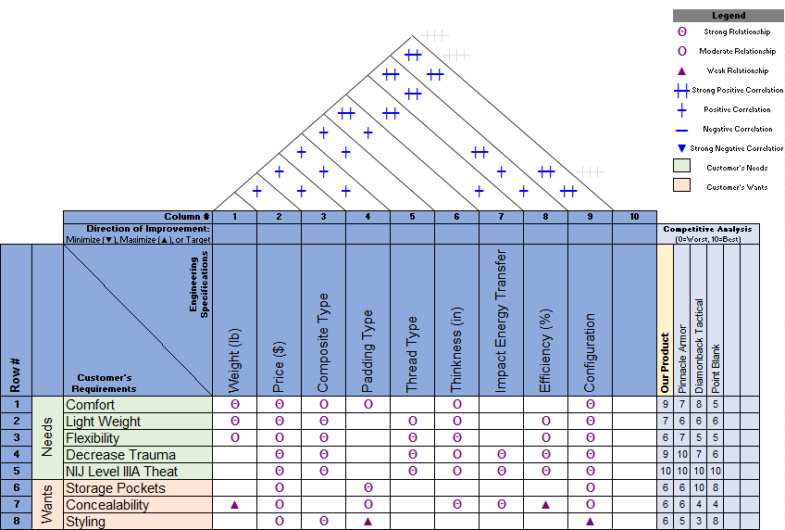
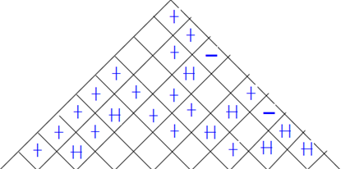
QUALITY FUNCTION DEPLOYMENT

Slide 11
FINAL DESIGN

Slide 12
FUNCTIONAL DECOMPOSITION
Material

Slide 13
BULLET IMPACT SIMULATION
Assumed Symmetry for Model
Bullet impacting center of protective layers
9” x 9” layers (1/4 of chest protective layer size)
1/4 of .357 SIG flat nose full metal jacket modeled
Bullet to impact bottom right of protective layers exactly in corner (symmetry)
BC’s are being assigned symmetry at bottom and right side of bullet/layers
Other sides layering set with only rotation limitations outward

Slide 14
MESH VIEW OF MODEL

Slide 15
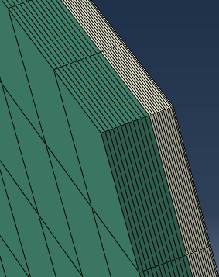
PROTECTIVE LAYERING
12 Kevlar and 12 Spectra
Kevlar-Green
Spectra-Grey
Kevlar .0118 meters
Spectra .006 meters
Thickness difference implies more Kevlar

Slide 16
.357 SIG FLAT NOSE FMJ
.354” Diameter
.4” Length
.003” Thick Cu Jacket
Lead- Red
Copper- Blue-green

Slide 17
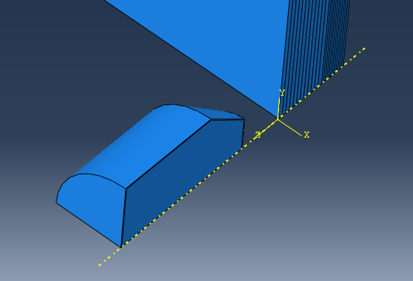
ASSEMBLY AND BCs
Assembled with Bullet Lined up at Bottom Right of Layering for Symmetry Assimilation
BCs for bottom and right sides of the bullet and layering for symmetry
Other layer BCs set with rotational condition preventing it from rotating out
.357 velocity set at -448m/s in Z

Slide 18
ABAQUS RESULTS
Numerical Results were Unable to be Obtained Due to Issues Obtaining a Program that Could Run the Model.
This Led to a Need to Come Up with Useful Physical Testing Method
Future Teams will be Able to Use the Program to Test and Improve Designs

Slide 19
DESIGN MODEL
18 in
16 in

Slide 20
MANUFACTURING

Slide 21
Bill of Materials
Product | Vendor | Quote
Kevlar KM2 | Infinity Composites Inc. | $95.02
Ballistic Spectra Fabric | Composite Envisions LLC. | $154.10
Kevlar Thread | The Thread Exchange | $21.37
Bungee Cord | Lowes | $20.52
.44 Mag Bullets | Remington | $50
Sand Bags | Lowes | $12
Lumber for Frame | Lowes | $20
Total: | - | $373.01

Slide 22
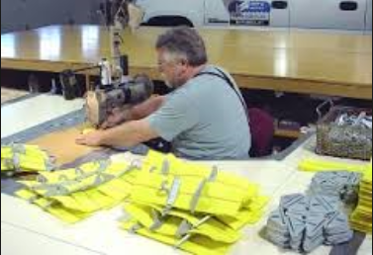
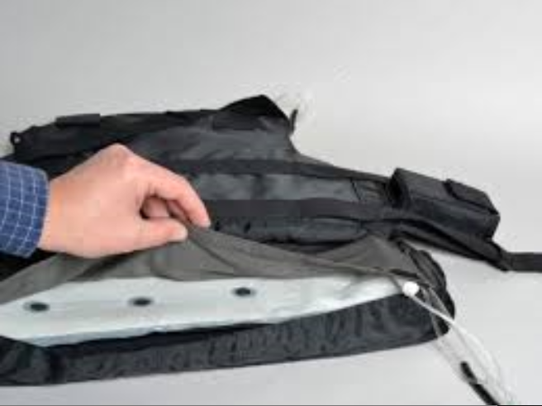
MANUFACTURING PROCESS
Cut Sheets of Kevlar KM2 and Spectra 1000 into the vest pocket shapes.
Place Fibers into chosen configuration.
Sew configuration with industrial machine (15.24 cm sewn sections to hold layers together).
Place the protective layers between nylon and seal it.

Slide 23
RETAIL PRICE
# Vests Produced: 4901
Production Cost: $355.09
Distributor Cost: $461.54
Profit: $106.45
Retail Price: $600
Target QFD Price: $600
Competitive Prices: $600-$800
Market Size: $3 Million

Slide 24
TEST DETAILS

Slide 25
TESTING GOALS
Test 1-
Analyze the Effect of Ply Orientation
Test 2-
Test Different Combinations
Analyze Kevlar and Spectra Behavior When Impacted
Test 3-
Investigate Aerial Weight and its Effect on Fabric Strength
Test 4-
Compare our Configuration with Real Life Vest (Exact Same Aerial Weight)

Slide 26
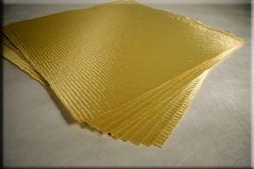
TESTING PROCEDURE
Cut 4in x 4in Sheets of Kevlar KM2 and Spectra 1000
Use All Kevlar Specimens to Create 3-24 Layer Sample Pads in Varying Ply Orientations
0 to 45 Degree Ply Alternating
0 to 45 Degree Ply
0 Degree Un-oriented

Slide 27
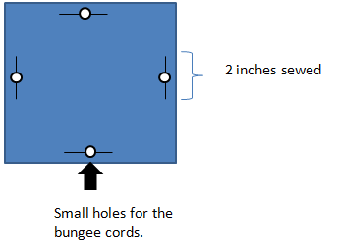
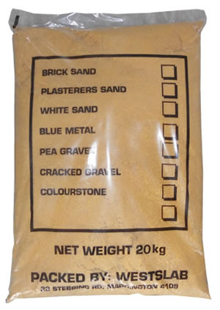
Hang Configuration using Bungee Cords Around Sand Bags
Use .357 Mag to Shoot the Protective Pads from Distance of 1 Foot
Analyze each Test Specimen to Determine Best Ply Orientation.

Slide 28
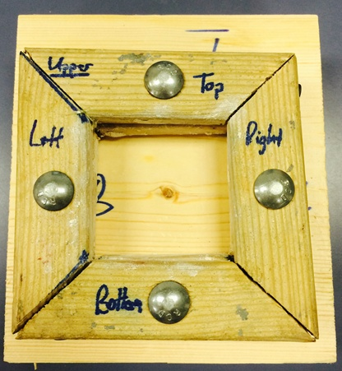
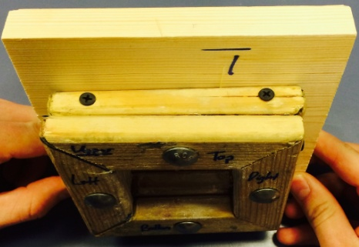
UPDATED TESTING PROCEDURES
Constrain Pads Clamping between Wooden Frames Using 4 Bolts through Frame (3ft-lb Torque Per Bolt)
Place Wood Backing With .625in Clay Barrier Behind Test Coupon
.625”
2.5”x2.5”

Slide 29
UPDATED TESTING PROCEDURE
Test 3 Configurations with 24 Layers & Vest Pad
12 Kevlar and 12 Spectra
24 Kevlar
24 Spectra
Match Kevlar and Spectra Aerial Weights with Varying Configurations
20 Kevlar 10 Spectra
16 Kevlar 20 Spectra
12 Kevlar 30 Spectra
Match Aerial Weight of Kevlar and Spectra Top Pads to Honeywell IIIa Gold Flex
25 Kevlar
20 Kevlar 13 Spectra
Honeywell IIIa Gold Flex

Slide 30
TESTING RESULTS

Slide 31
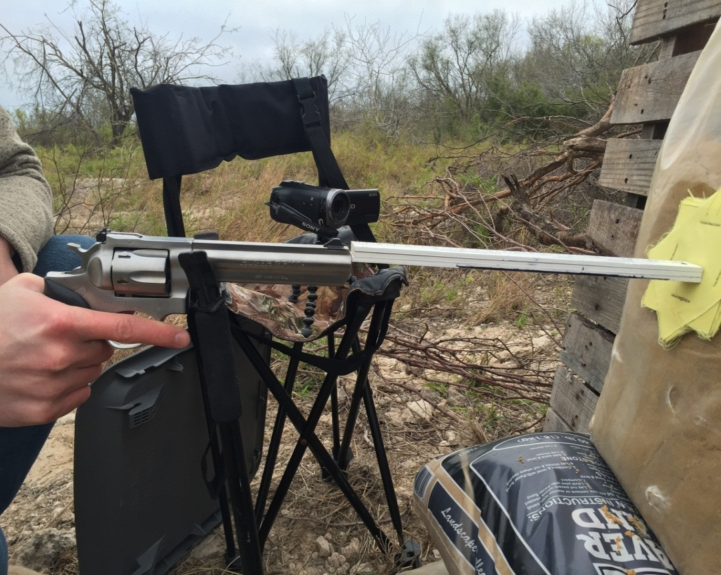
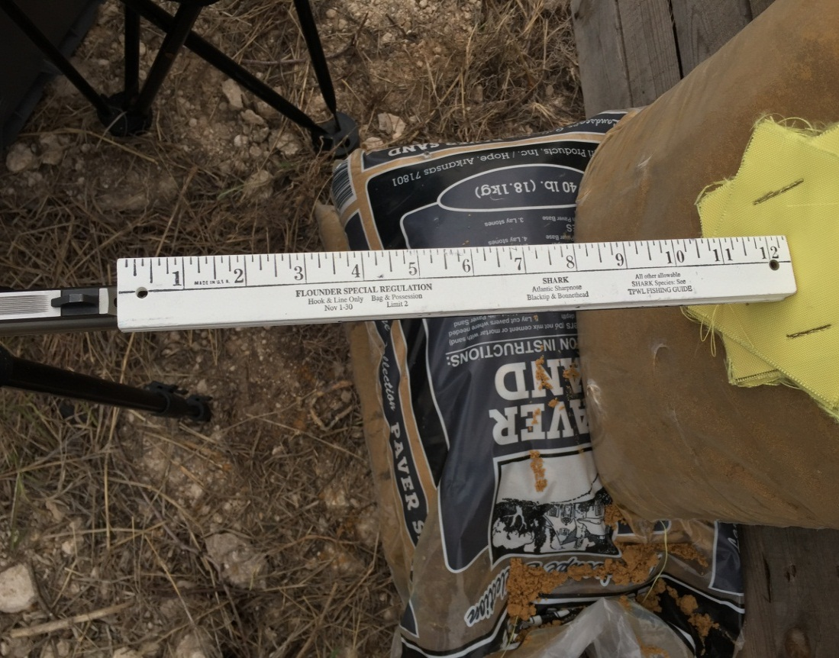
TEST 1 SETUP
Shooting Distance: 1 Foot
Bullet Used: .357 Magnum SJHP (125grain)
Restrains: None (Freely Hanging)

Slide 32
VIDEO OF TEST 1 IMPACT

Slide 33
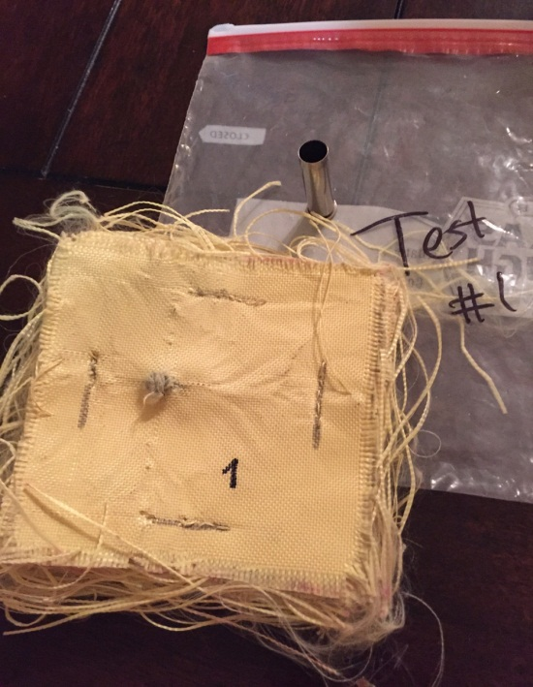
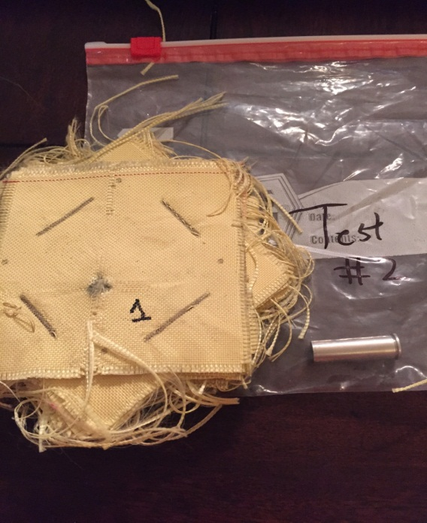
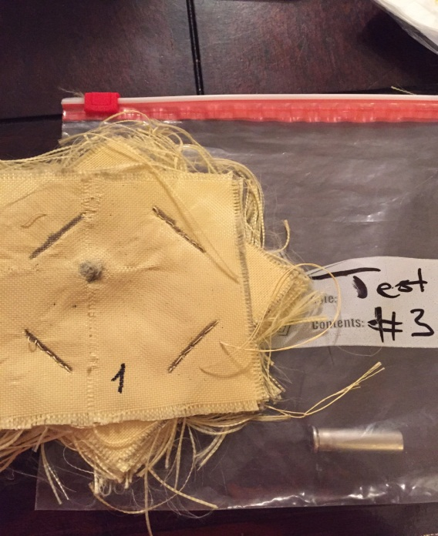
TEST 1- SAMPLES
Sample 1
24 Layers Kevlar
No Variation in Ply Orientation
Sample 3
24 Layers Kevlar
0 to 45 Degree Ply Alternating
Sample 2
24 Layers Kevlar
0 to 45 Degree Ply Alternating Every Other

Slide 34
TEST 1 VISUAL RESULTS
Back Front

Slide 35
QUANTITATIVE RESULTS
INCONCLUSILVE/ UNRELIABE
WHY..
Sand Absorbed much of impact due to allowed motion of pad since they were unrestrained
Single Tests conducted and some of results could be outlying values on bell curve (not enough testing)
Video results in hint to need for new testing method

Slide 36
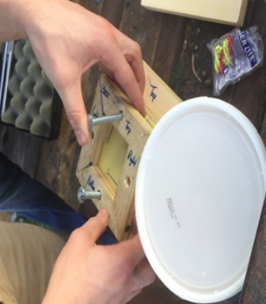
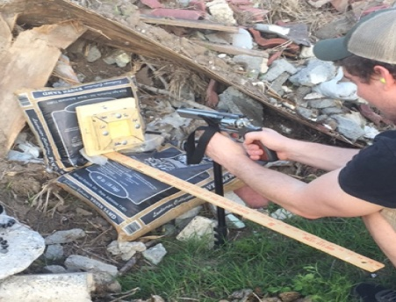
TESTS 2-4 SETUP
Shooting Distance: 1 Foot
Bullet Used: .357 Magnum SJHP (125grain)
Restraints: Wooden Frame with Clay Backing (3 ft-lb per bolt)

Slide 37
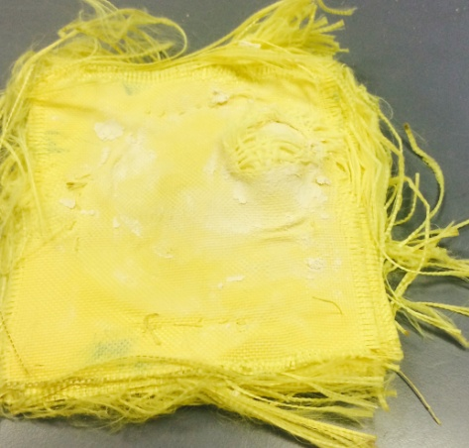
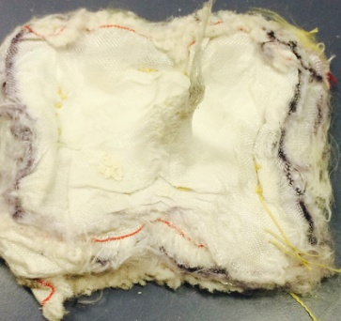
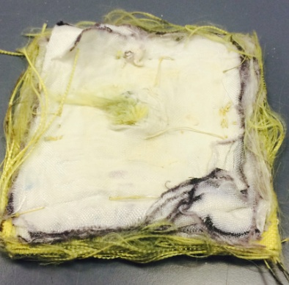
TEST 2- SAMPLES
Sample 1
24 Layers Kevlar
Sample 2
24 Layers Spectra
Sample 3
12 Layers Kevlar
12 Layers Spectra

Slide 38
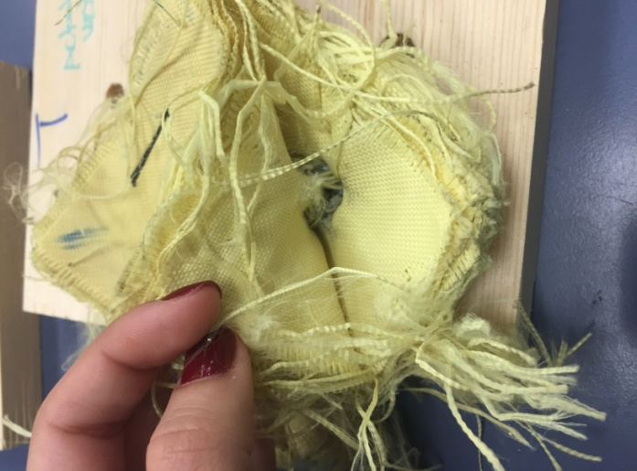
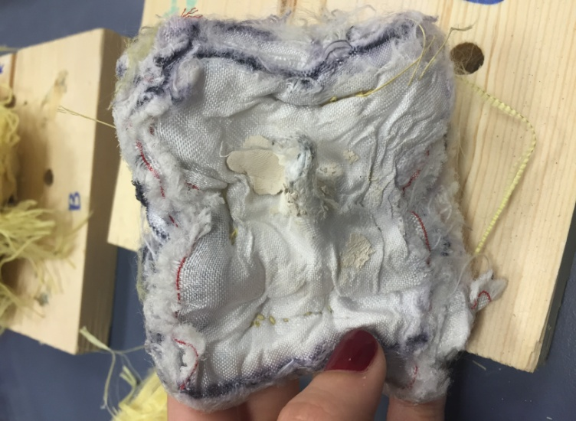
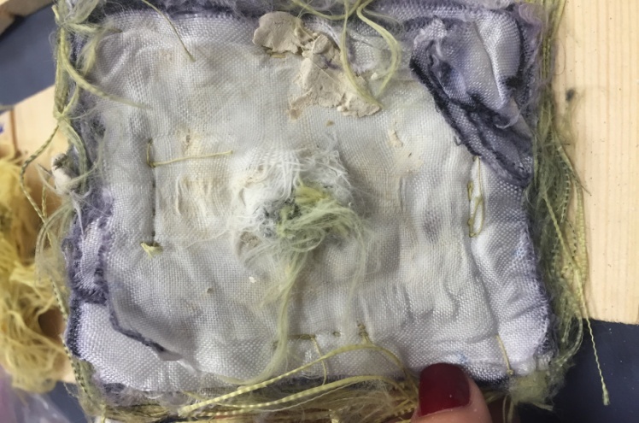
TEST 2 VISUAL RESULTS
24 Layers Kevlar
24 Layers Spectra
12 Kevlar, 12 Spectra

Slide 39
QUANTITATIVE RESULTS
 | 24 Kevlar | 24 Spectra | 12K, 12S
Layers Penetrated | 6 | 24 | 24
Volume Affected | .0089in^3 | - | -
Back Indention (Height, Area) | .469in and 1.03in^2 | - | -

Slide 40
TEST 2 OUTCOMES
24 Kevlar Sample Stopped the Bullet
24 Spectra and 12K12S Pad Were Compromised by Bullet Impact
24 Spectra had Least Energy Dissipation Based on Hole Left in Wood
24 Kevlar Sample Most Successful in Decreasing Bullet Energy and Trauma

Slide 41
FURTHER TESTING
Investigate Aerial Weight and its effect on Fabric Strength
Create a Kevlar and Spectra Pad using Aerial Weight Matching System for Layers
Investigate Laminating Layers

Slide 42
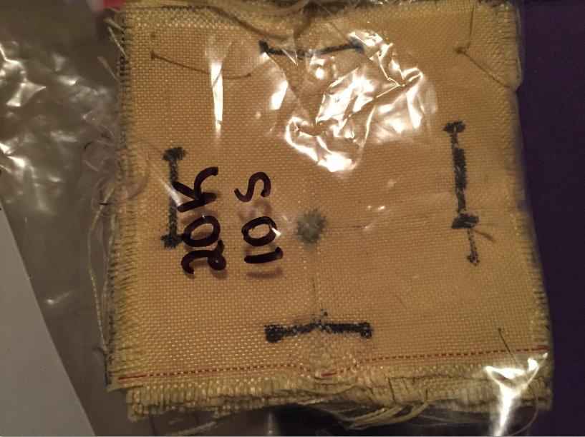
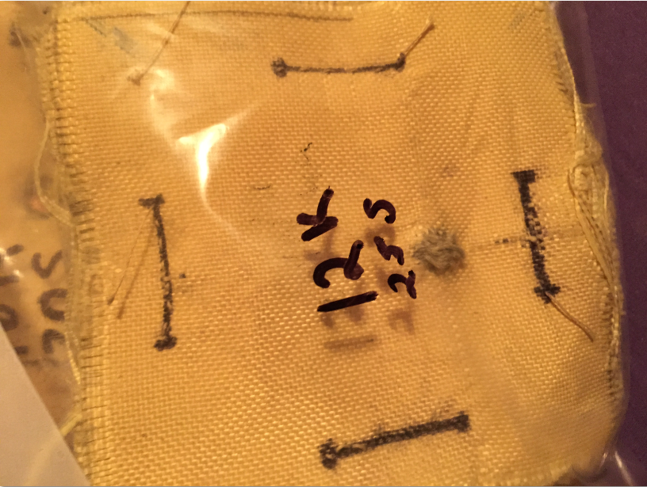
TEST 3 – SAMPLES
Sample 1
20 Kevlar, 10 Spectra
Sample 2
16 Kevlar, 20 Spectra
Sample 3
12 Kevlar, 30 Spectra

Slide 43
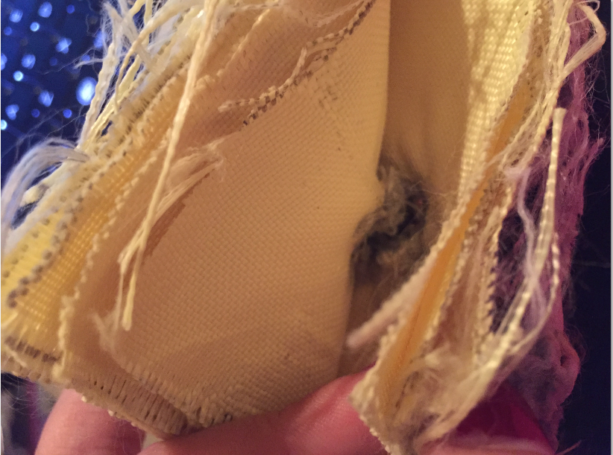
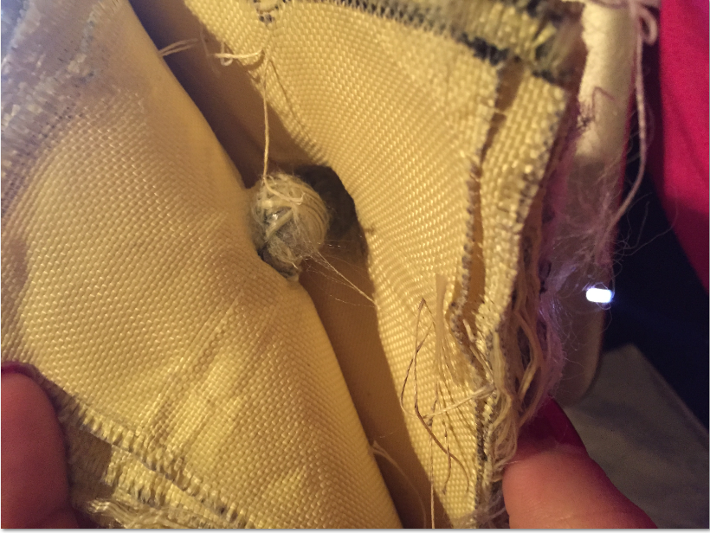
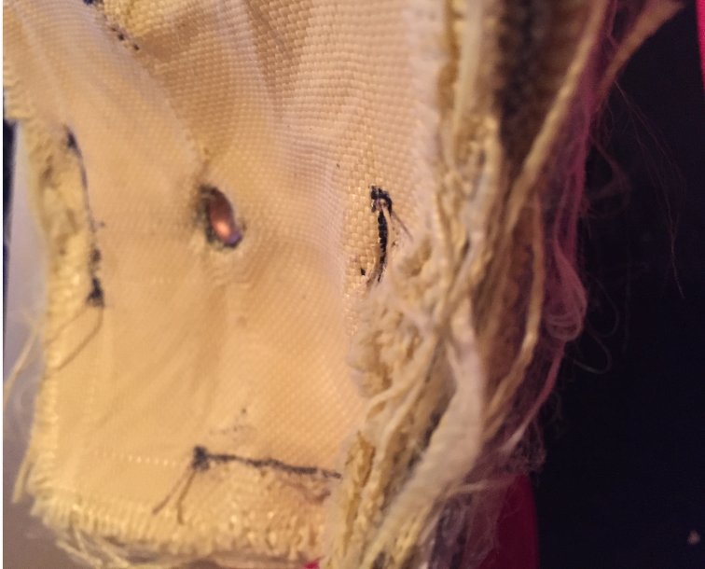
TEST 3 VISUAL RESULTS
12 Kevlar, 25 Spectra
20 Kevlar, 10 Spectra
16 Kevlar, 20 Spectra

Slide 44
QAUNTITATIVE RESULTS
16 K,20 S Unreliable

Slide 45
TEST 3 OUTCOMES
All 3 Different Samples Stopped the Bullet.
Confirm Aerial Weight Affects Strength
12 Kevlar-25 Spectra and 20 Kevlar-10 Spectra Successful
16Kevlar-20Spectra Data Unreliable Due to Knot in Wood’s Affect on Impact

Slide 46
FURTHER TESTING
Test Commercial Product with Goldflex IIIa Protective Layering
Compare Aerial Weight of Kevlar and Spectra to Commercial Product
Create all Kevlar Pad Based on Comparative Aerial Weight
Create Kevlar-Spectra Layering Based on Comparative Aerial Weights

Slide 47
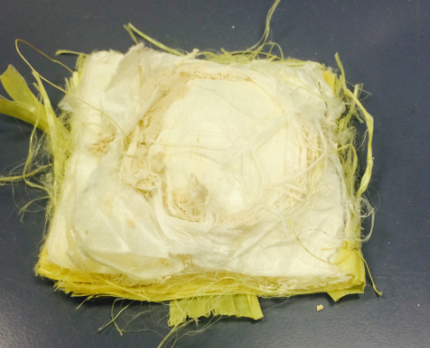
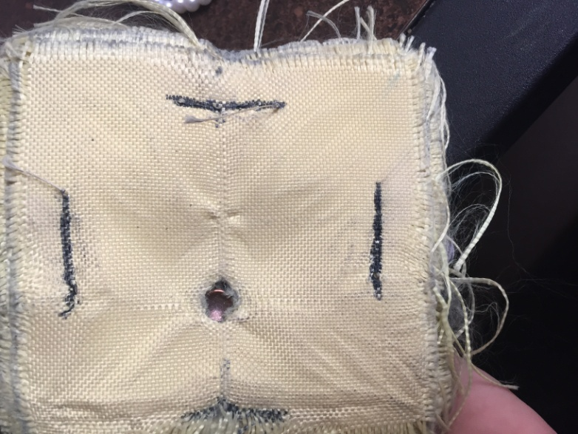
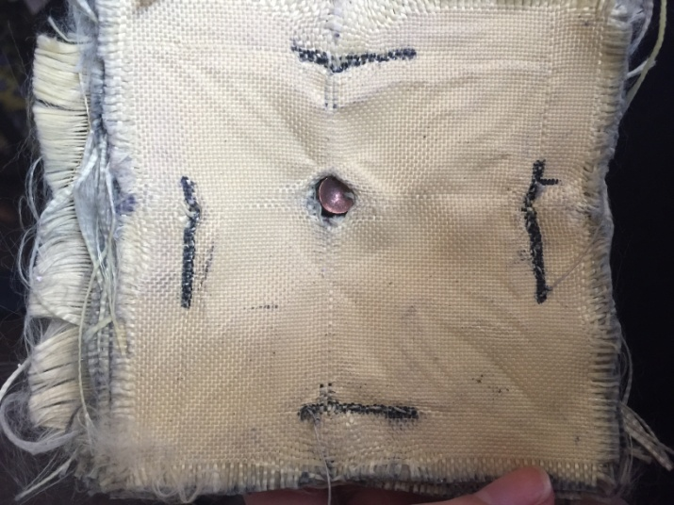
TEST 4 – SAMPLES
Sample 1
Commercial Product
Sample 2
25 Kevlar
Sample 3
20 Kevlar, 13 Spectra

Slide 48
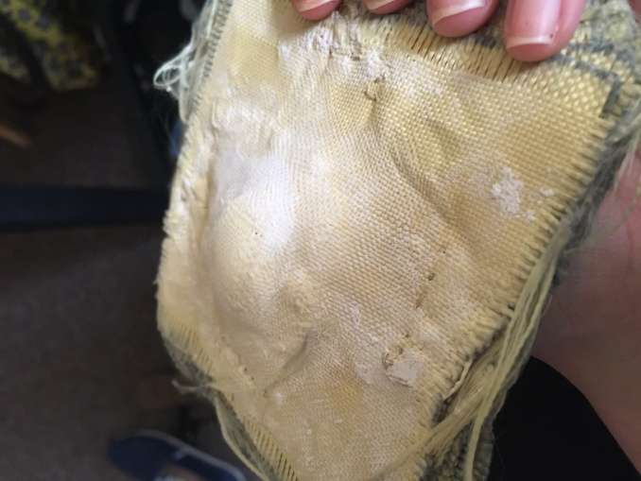
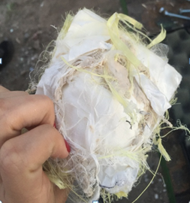
VISUAL RESULTS
20 Kevlar, 13 Spectra
25 Kevlar
Commercial Product

Slide 49
QUANTITATIVE RESULTS

Slide 50
TEST 4 RESULTS
All Samples Successful in Stopping Bullet
Commercial Product with Goldflex IIIa Protective Padding Displayed Greatest Energy Dissipation of Bullet
Due to Lamination, Breathability of Goldflex IIIa Product is Less than that of Kevlar/Spectra Non Laminated Layers
Kevlar with Spectra Layering Next Best at Dissipating Bullet Energy Based on Area of Bump Bullet Left from Impact (Lower Pressure)

Slide 51
RESULTS & DISCUSSSION

Slide 52
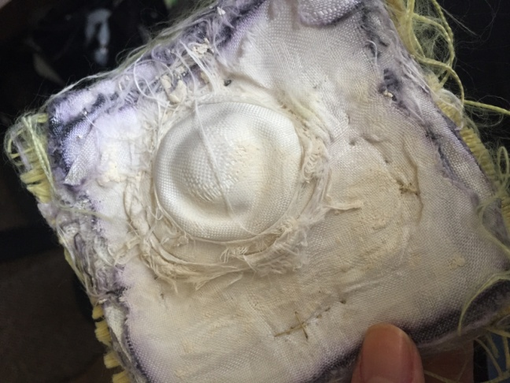
TOP DESIGN
20 Kevlar, 13 Spectra
Least Body Trauma Based on Resulting Bump Area
Matches Weight of Commercial Product
Increased Breathability Compared to Commercial Product due to Lack of Lamination
BACK
FRONT

Slide 53
BEST PRACTICES
Using Smaller Sections of Material to Make Test Pad instead of Creating Multiple Vests to Test
Designing More Consistent Testing Method to Alleviate Undesired Variables
Matching Aerial Weight of Commercial Product to Our Product

Slide 54
LESSONS LEARNED
More Time Spent On Planning and Organizing Leads to Less Time Working on the Project, Lower Costs, and Greater Efficiency
Don’t be Afraid to Ask for Advice

Slide 55
TIMELINE

Slide 56
GANTT CHART
 | January |  | February |  |  |  | March |  |  |  |  | April |  |  |  | May
Plan | 19 | 26 | 2 | 9 | 16 | 23 | 2 | 9 | 16 | 23 | 30 | 6 | 13 | 20 | 27 | 4 | 11
Technical Presentation
Develop Ply Oriented Test Coupon
Test Ply Oriented Coupons
Develop Coupons with Same Number of Layers
Test Same Laye r Count Coupons
Develop Coupons w/Alternating Kevlar and Spectra
Test Coupons with Alternating Kevlar and Spectra
Develop Coupons Matching Aerial Weight of Goldflex II1a
Test Matching Aerial Weight Coupons
Run Abaqus Model
Finish Final Report
Final Presentation

Slide 57
SUMMARY
Overview
Final Design
Market Analysis/Cost
Manufacturing
Timeline

Slide 58
FUTURE RECOMMENDATIONS
Develop Coupons Using Lamination for Kevlar KM2 and Spectra 1000 Combinations
Order Lighter Aerial Weight Kevlar and Higher Aerial Weight Spectra and Create Pads of Materials with Matching Aerial Weight Values to Find Optimal Range
Run ABAQUS Program and Investigate Varying Configurations
Add Polymer/ Polymer Nanofiber Coating to Configurations

Slide 59
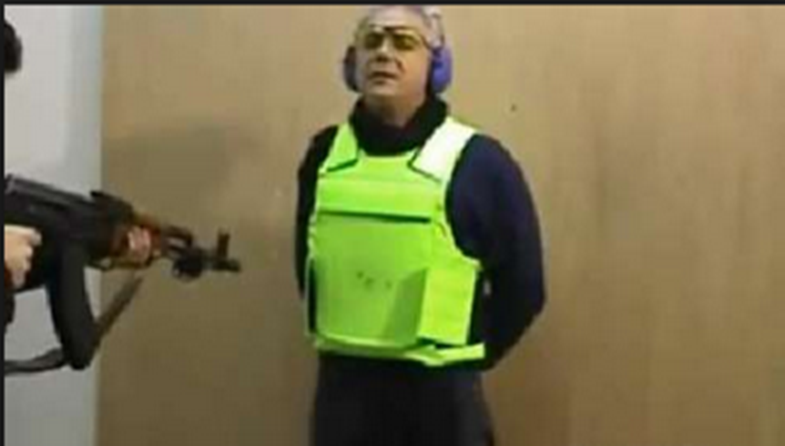
QUESTIONS
Dr. Sarkar Approved

Slide 60
REFERENCES
Armor UP L.P. Dba." BulletProofME.com Body Armor/ Bullet Proof Vests.N.p.,n.d.Web.23 Nov.2014.
"Body Armor Manufacturing in the US: Market Research Report." Body Armor Manufacturing in the US Market Research. IBISWorld, 2014. Web. 23 Nov. 2014.
"Boron Carbide (B4C) - Properties and Information about Boron Carbide." Properties:. AZOM, n.d. Web. 10 Oct. 2014. <http://www.azom.com/properties.aspx?ArticleID=75>.
"Carbon Fiber Characteristics." Carbon Fiber Properties. N.p., n.d. Web. 10 Oct. 2014. <http://www.christinedemerchant.com/carboncharacteristics.html>.
Cheng, Ming, Weinong Chen, and Tusit Weerasooriya. "Mechanical Properties of Kevlar® KM2 Single Fiber." Journal of Engineering Materials and Technology 127.2 (2005): 197. Web.
Fact Sheet. Atlanta, Ga. (1600 Clifton Road, N.E., Atlanta 30333): ATSDR, 1990. Web
"Kevlar Bullet Proof Vests." About.com Inventors. About.com, n.d. Web. 23 Nov. 2014.
"Large Bullet Proof Body Armor Level IIIA." Rugged Earth Sports. N.p., n.d. Web. 23 Nov. 2014.
Mechanical Properties of Carbon Fibre Composite Materials, Fibre / Epoxy Resin (120°C Cure). Performance Composites, July 2009. Web. 10 Oct.
2014. <http://www.performance-composites.com/carbonfibre/mechanicalproperties_2.asp>.
Spectra Fiber 1000 High Strength Light Weight Polyethylene Fiber. Honeywell, n.d. Web. 12Oct.2014. <http%3A%2F%2Fwww.honeywell.com%2Fsites%2Fservlet%2Fcom.merx.npoint.s
ervlets.DocumentServlet%3Fdocid%3DD19CB058F-D839-EA79-85BC-E26A581EAB36>.
"United States Department of Defense." Defense.gov Contracts for Thursday, August 07, 2008. N.p.,n.d. Web. 23 Nov. 2014.

Slide 61
APPENDIX

Slide 62
PRODUCTION COST
 | Unit | Year
Labor Cost: Employees - 10 production, 2 engineers,1 manager | $112.22 | $550,000
Material Cost | $183.64 | $900,000
Total of Material Plus Labor (Rounded) | $316.26 | $1,550,000
Production Cost (includes 20% Overhead) | $355.09 | $1,740,000
Distributor Price (30% Profit) | $461.54 | $2,262,000
Retail Cost (30% Profit) | $600 | $2,940,600

